Slide 1
Unmanned Aircraft System Concept Design
Amrith Surendra

Slide 2
Content
Introduction to, and Categorisation of UAS
System Engineering Approach to Design
Multidisciplinary Nature of UAS Design
System Level Multi-Objective Optimisation
Decision Support Framework

Slide 3
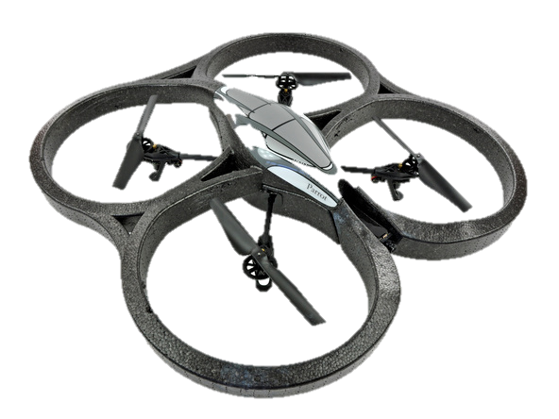
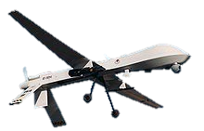
Categorisation of UAS
What are Unmanned Aircraft Systems (UAS), and how do you categorise them?
Definition: “A flying vehicle that can be operated autonomously or remotely, can be expendable or recoverable, and can carry a lethal or nonlethal payload…..” - U.S. Department of Defense (DOD).
This can range from :
These systems are at present classified by the mass of the vehicle. The Civil Aviation Authority (CAA) classification table:
AR Drone
Cost - £250
Predator
Cost - £3-6 Million (approx.)
Class | Category | Normal operating altitude | Civil category (UK CAA)
Class I < 150 kg | Micro < 2kg | Up to 200 ft AGL | Small Unmanned Aircraft (<20 kg)
 | Mini 2-20 kg | Up to 3000 ft AGL
 | Small 20-150 kg | Up to 5000 ft AGL | Light Unmanned Aircraft (20-150 kg)
Class II 150-600 kg | Tactical | Up to 10,000 ft AGL | Weight category group 3 (> 150 kg)
Class III > 600 kg | Medium Altitude Long Endurance (MALE) | Up to 45,000 ft AGL
 | High Altitude Long Endurance (HALE) | Up to 65,000 ft AGL

Slide 4
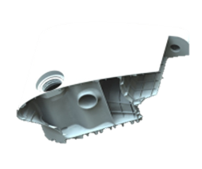
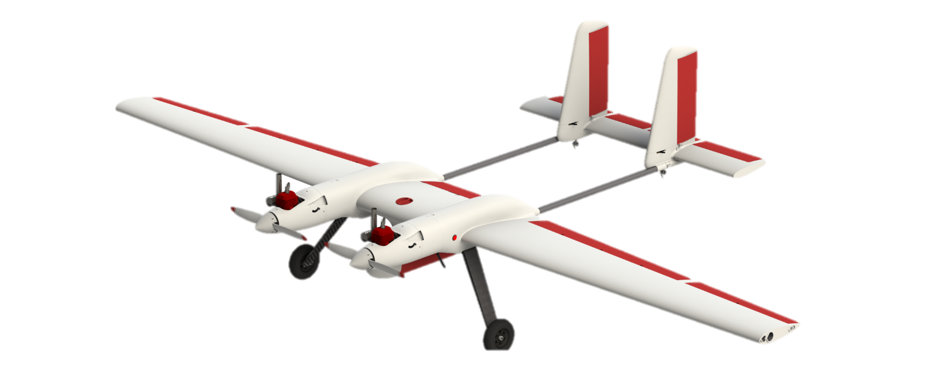
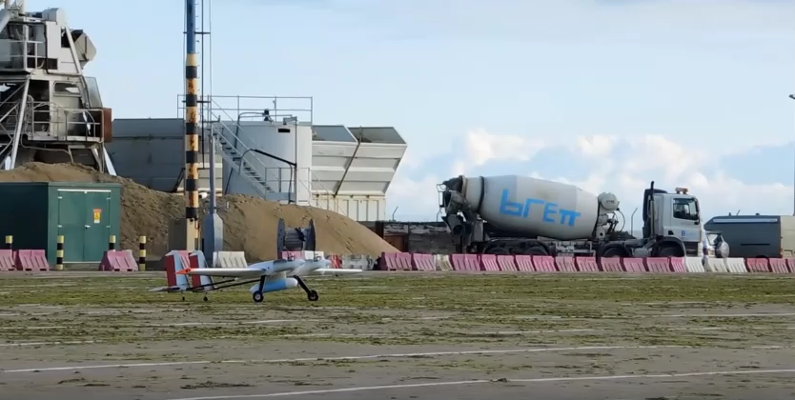
Case study
The following case study will be used to illustrate some of the concepts that will be discussed in this presentation.
The 2Seas project is a joint collaboration with academia and industry to develop a low-cost UAS to provide maritime surveillance across the English Channel.
University of Southampton was involved in designing the airframe and integrating key sub-systems into the aircraft.

Slide 5
Systems Engineering Approach
Before staring the process of design and optimisation it is important to understand the requirements of the system under consideration.
Classification of Requirements:
Operational Requirement: Defines the fundamental purpose of the system under consideration.
Functional Requirements: What the system has to do in order to meet the operational requirement.
Non-functional Requirement: Define how well a particular function has to perform. These typically define constraints imposed on the system.
Defining requirements in such a manor will lead to a hierarchical structure of functional requirements, with top-level requirements defining high-level system functions and lower level requirements defining sub-system level functions.

Slide 6
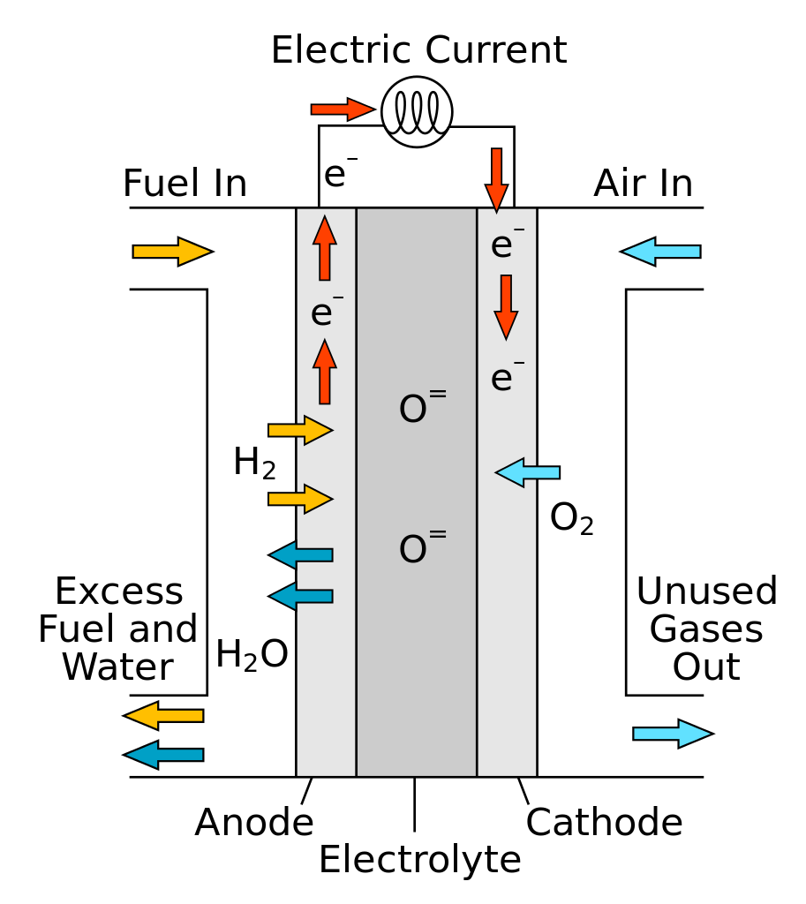
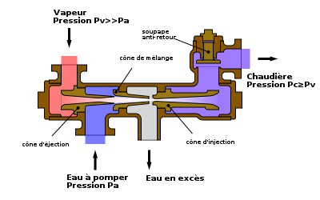
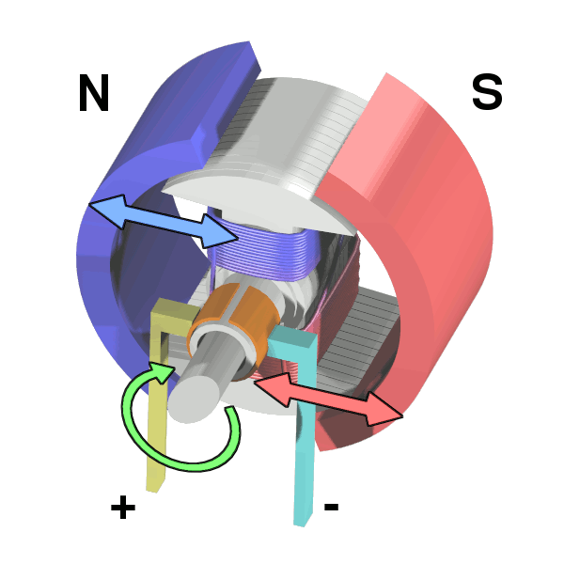
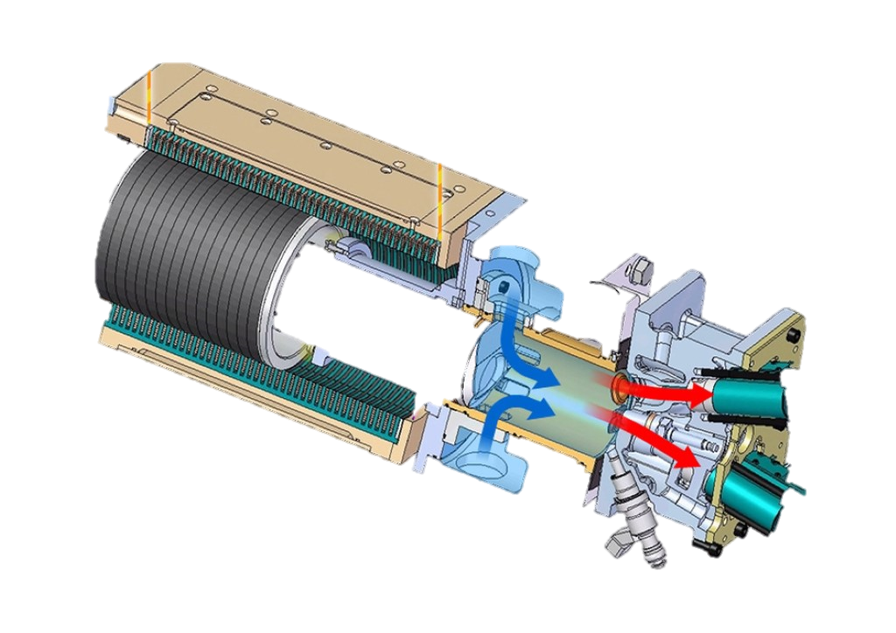
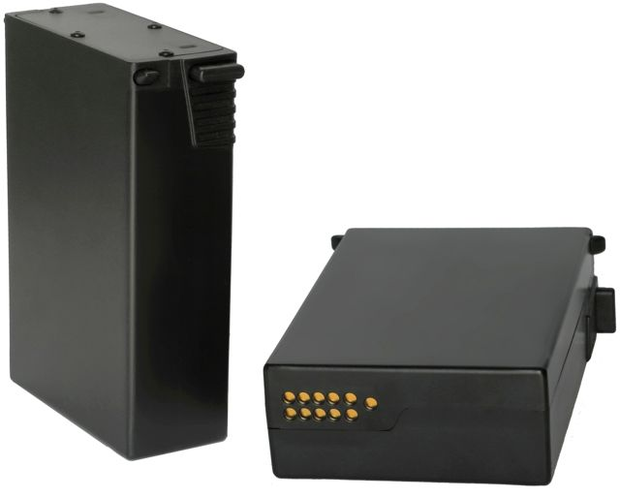
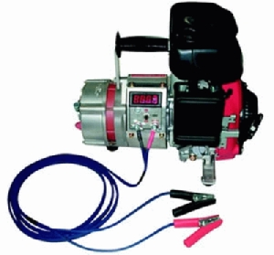
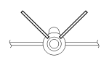
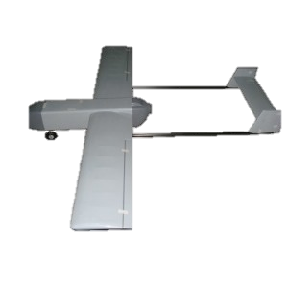
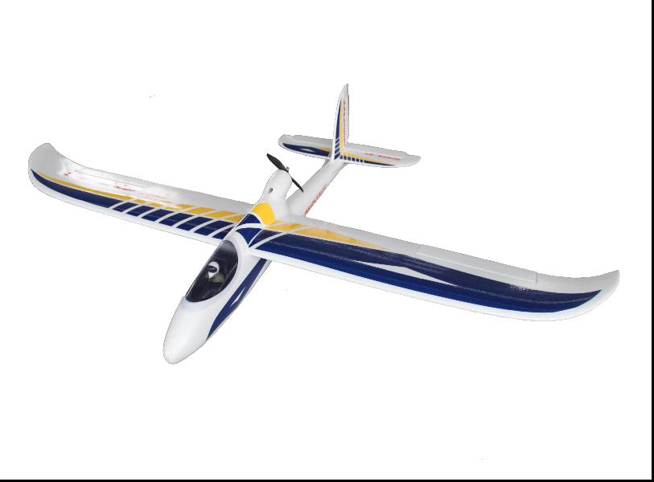
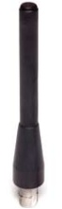
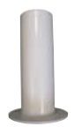
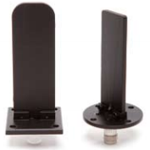
Concept Selection
For each system function identify a set of system alternatives that satisfies those functions – Functional Design
Function | Alternative Designs
Deliver Propulsive Power | Piston engine | Electric motor | Fuel Cells
Deliver Electrical power | Engine generator | Battery | Engine Generator + Battery
Provide stability and control for steady flight | Conventional Tail | V-Tail | H-Tail
Provide communication of data | Omni-Dipole, vertically polarization, Gain 2dBi | Omni- circular polarization, Gain 3dBi | Bladed Antenna, Omni -Dipole, vertical polarization, Gain 2dBi
. . . | . . . | . . . | . . .
The output of this process should result in a set of system architectural concepts that are taken forward for analysis and evaluation.
An architecture is defined as a composition and organisation of system elements and the communication networks.
Concept 2
Concept 1

Slide 7
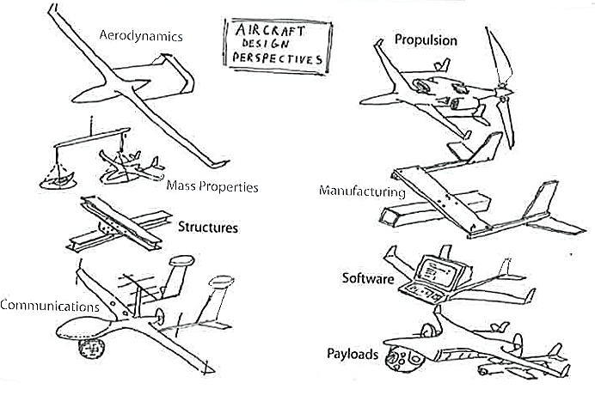
Multi-Disciplinary Nature of Design
The design of an UAS requires balance of multiple system elements, and cannot be designed in isolation of other system elements.
This requires a multi-disciplinary approach, where multiple system elements are modelled to better understand the inter-relationships between these elements. This in-turn will allow us to trade between different design alternatives in order to improve the overall system performance.
In this presentation the following disciplines will be described in more detail:
Geometry Definition and Aerodynamic Analysis
Propulsion Systems
Communication Systems
Payload Sensor Analysis.

Slide 8
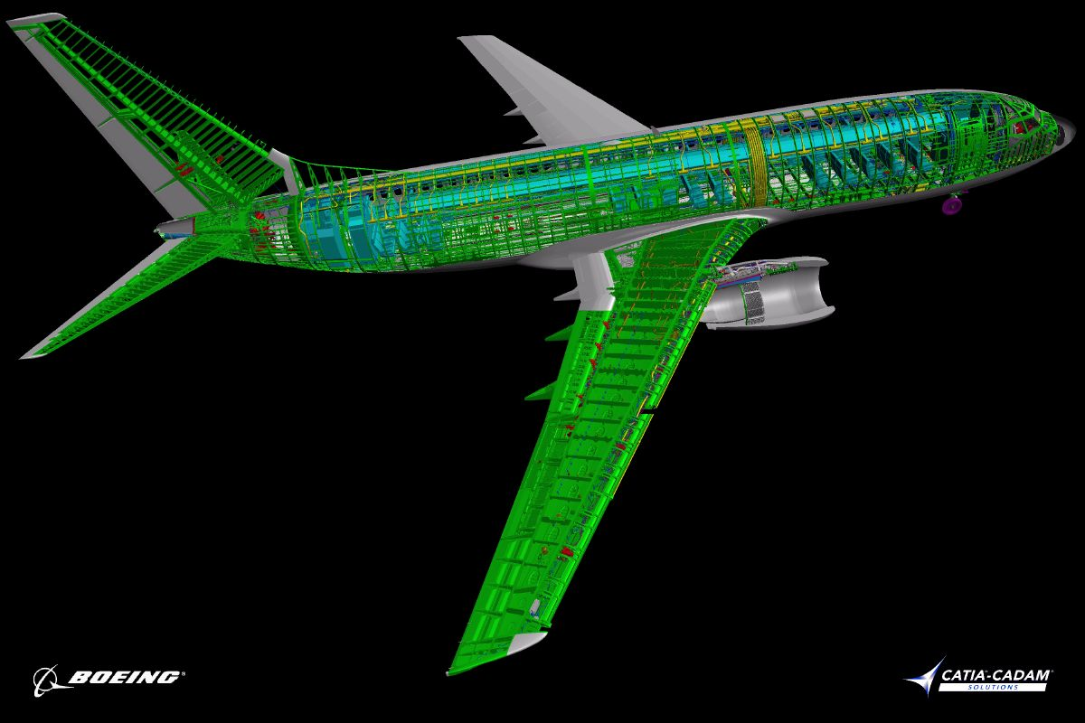
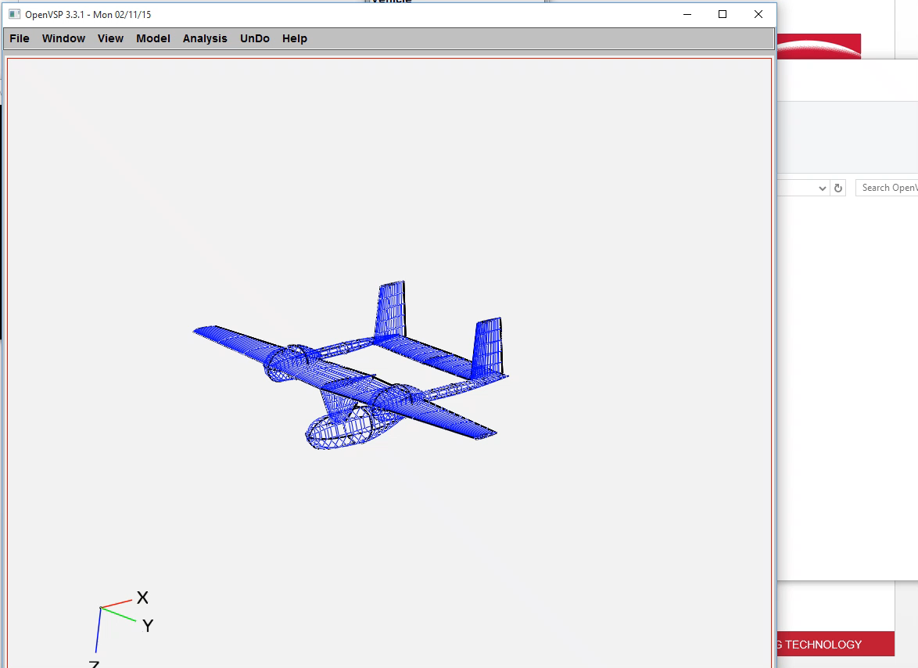
Geometry Definition & Aerodynamic Analysis
At the conceptual design stage, the representation of an UAS geometry has to be relatively simple with few parameters defining the shape and size of the UAS.
Using CAD packages will result in complex geometries that are hard to change parametrically. It is recommended simpler packages, such as OpenVSP to be used.
OpenVSP is an open source tool, originally developed by NASA, that allows the user to define simple aircraft components and automatically parameterise it.
Aerodynamic Analysis
Low fidelity Model: Vortex Lattice Method, which has a low computational expense and a low upfront setup cost.
High Fidelity Model: Computational Fluid Dynamics (CFD), which can be computationally
very expensive.

Slide 9
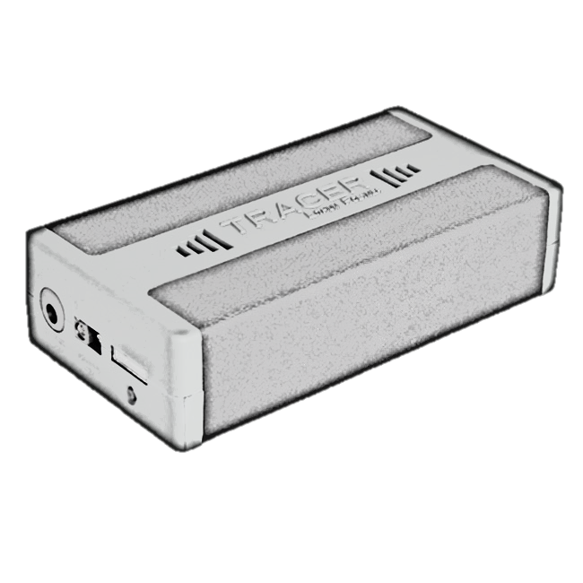
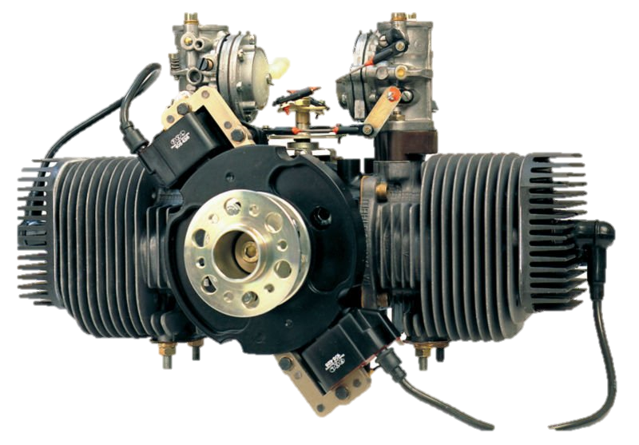
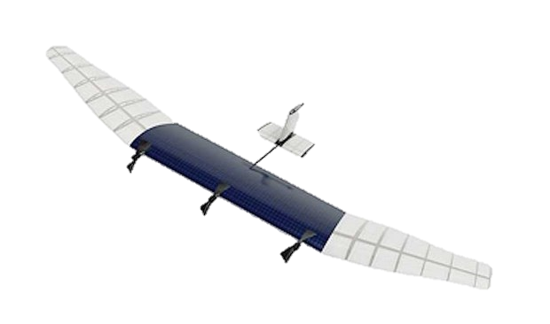

Choice of Propulsion System
Propulsion systems play a vital role in defining the performance of an UAS, as it provides the power required for the aircraft to take-off and accelerate, and can also provide electrical power required to drive the on-board flight critical systems and the payload system.
UAS’s utilise different types of propulsion systems. Commonly used propulsion systems are battery powered, and reciprocating engines. But other alternative technologies, such as fuel cells and solar cells are also being used.
For example consider the trade between piston engine and battery powered propulsion:
$P_{Shaft,Prop}=1.5 kW, P_{electric}=0.5 kW$. Total Power required during flight = $2 kW$
Power-to-weight ratio of the engine = $P/W=1.1 kW/kg$, $BSFC=0.9{kg}/{kWhr}$
Battery Powered brushless DC Motor. Lithium polymer battery (Li-Po) – Specific Energy = $0.6 kWhr$/kg.
Shift in line due to additional mass of piston engine integration
Research in other more novel energy sources, such as fuel cells and solar arrays are being conduced.
The aim here is improve the specific energy of the power source in order to make electric propulsion more viable.

Slide 10
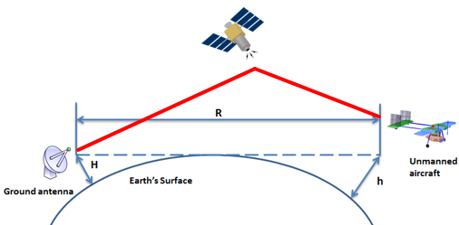
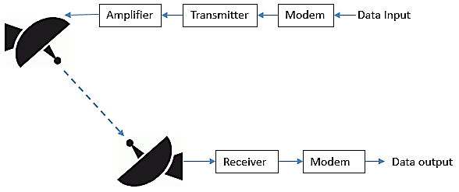

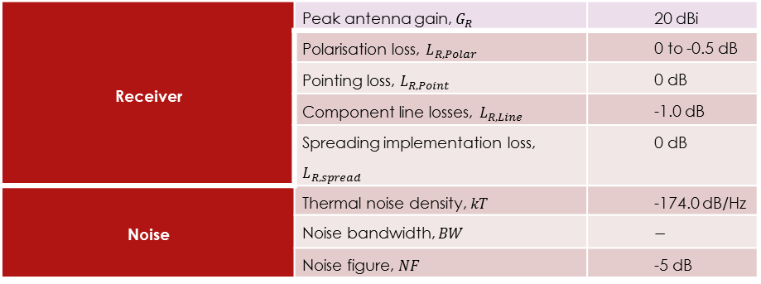
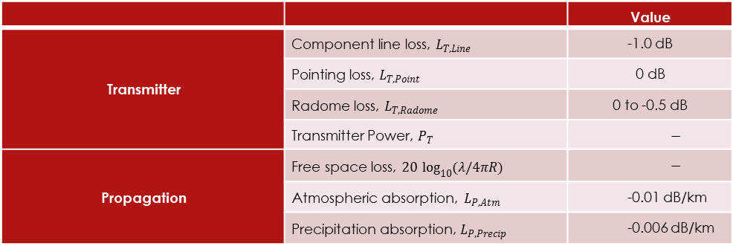
Communications Systems
It is important that the UAS be able to transmit and receive data/commands to and from the ground control station.
The performance of a communication link is defined by its Signal-to-Noise ratio (SNR). SNR defines the ability of the receiver to recover the transmitted data.
At the conceptual design stage Link Budget analysis is employed to identify the SNR at the receiver, and understand the factors that drive communication system design. ${\left(\frac{S}{N}\right)}_{Avilable}=\frac{P_{T}∙G_{T}∙L_{T}∙L_{P}∙G_{R}∙L_{R}}{k∙T∙B∙F}{\left(\frac{λ}{4π∙R}\right)}^{2}→\frac{S}{N}∝\frac{1}{R^{2}}$
Typical example of link budget analysis:
SATCOM
BLOS
LOS
 |  | Value
Transmitter | Component line loss, $L_{T, Line}$ | -1.0 dB
 | Pointing loss, $L_{T, Point}$ | 0 dB
 | Radome loss, $L_{T, Radome}$ | 0 to -0.5 dB
 | Transmitter Power, $P_{T}$ | $$−$$
Propagation | Free space loss, $20 \log_{10}{(λ/4πR)}$ | $$−$$
 | Atmospheric absorption, $L_{P, Atm}$ | -0.01 dB/km
 | Precipitation absorption, $L_{P, Precip}$ | -0.006 dB/km
Receiver | Peak antenna gain, $G_{R}$ | 20 dBi
 | Polarisation loss, $L_{R,Polar}$ | 0 to -0.5 dB
 | Pointing loss, $L_{R,Point}$ | 0 dB
 | Component line losses, $L_{R,Line}$ | -1.0 dB
 | Spreading implementation loss, $L_{R,spread}$ | 0 dB
Noise | Thermal noise density, $kT$ | -174.0 dB/Hz
 | Noise bandwidth, $BW$ | $$−$$
 | Noise figure, $NF$ | -5 dB

Slide 11
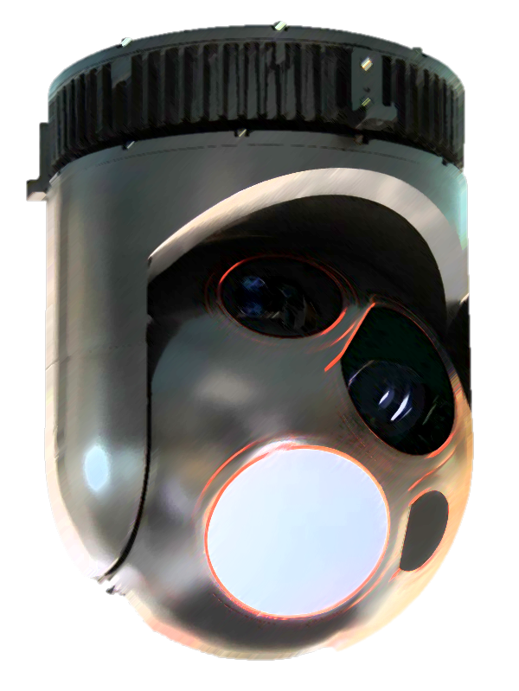
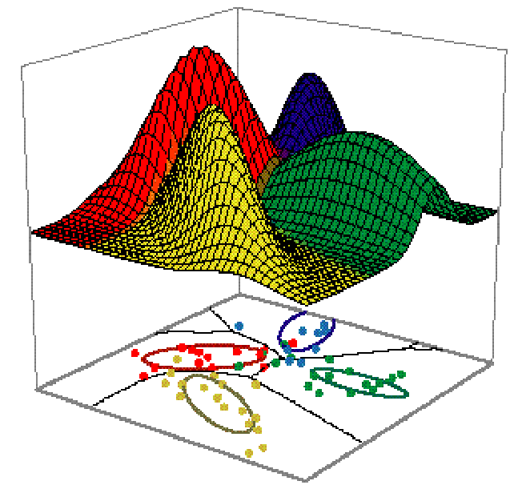
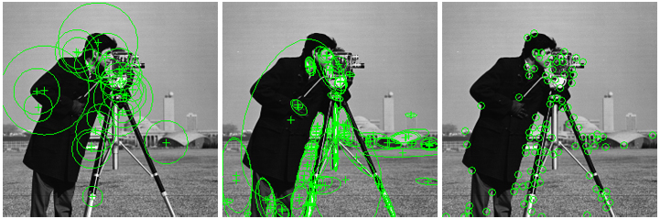

Payload Sensor Systems
The bandwidth required to transmit data to the receiver is directly related to the rate of data generated by the payload sensor system.
${\left(\frac{S}{N}\right)}_{Required}∝\left(\frac{R_{Data}}{B}\right)$
This presentation will focus on the optical camera system that transmits HD footage back to the ground control station.
$R_{Data}=H_{Pix}∙V_{Pix}∙\frac{Bits}{Pixel}∙Rate_{Frame}∙F_{compression}$. For a 1080 x 1080 camera this is going to be:
$R_{Data}=1080∙1080∙10∙5∙\frac{1}{2}=29.16 MBits/sec$
The collection of data is often substantially greater than what can be transmitted, given the limited bandwidth available. To overcome this limitation, on-board data storage devices are considered.
Other more intelligent methods consider the use of computer vision to identify the object and machine learning algorithms to identify the type of the object. This is used to transmit data back if the type of object is of interest to the user.

Slide 12
System Optimisation Approach
Before the process of optimisation can be begin we need to Identifying an appropriate objective function that captures all the important system metrics.
Returning back to the system engineering approach, the fundamental objectives of the system can be identified by defining the objective hierarchy of the system.
Fundamental Objectives:
Maximise range
Maximise coverage area
Maximise sensor detection capability
Maximise operational availability
How to optimise several, and potentially conflicting objectives?
Maximise operational effectiveness
Maximise Range
Maximise coverage area
Maximise sensor detection capability
Maximise operational availability
Maximise communication range
Minimise fuel consumption
Maximise loiter time
Maximise sensor field of view
Maximise sensor resolution
Maximise system reliability

Slide 13
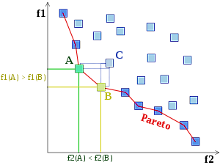

Multi-Objective Optimisation
The underpinning of multi-objective optimisation lies in theory of Pareto Optimality.
“ Pareto Optimality refers to a situation where no improvement to one objective can be made without making at least one other objective worse off.”
Minimise $f1$ and $f2$
$f_{i}^{1}≤ f_{i}^{2 }∀i∈\{1,2,….,k\}$ and $f_{i}^{1}<f_{i}^{2}$ for at least one $i$
A simple way of identifying Pareto optimal solutions is via the weighted sum method:
$$Min F\left(X\right)=\sum_{n=1}^{N}{w_{i}f_{i}(X)}$$
$$s.t. X∈Ω W=[w_{1},w_{2},…,w_{N}]$$
Other more advanced methods, such Genetic Algorithms have proven to be more efficient and robust in finding the Pareto optimal sets.
Dominated Solutions

Slide 14
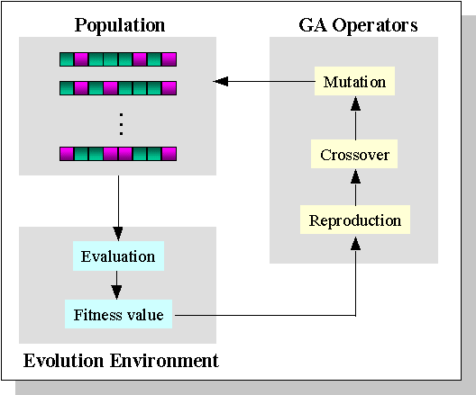
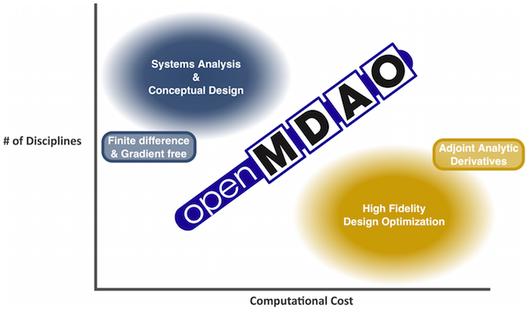
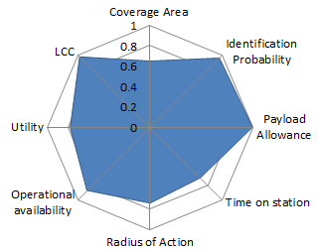
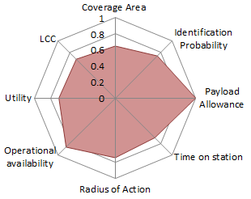

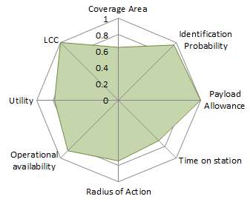
Genetic Algorithms
Genetic Algorithms are a type of evolutionary algorithm.
Create a parent and offspring population and combine both to generate $R_{t}=P_{t}∪Q_{t}$. Then, perform a non-dominated sorting of $R_{t}$ and identify different fronts $F_{i}$ $i=1,2,…,$etc.
Perform archive update to generate $P_{t+1}$of size $N$.
Perform selection on $P_{t+1}$, binary tournament selection with replacement to fill the mating pool by using the crowding distance.
Apply crossover and mutation operators to the mating pool from the previous step to generate $Q_{t+1}$.
Open source tools, such as OpenMDAO developed by NASA, provide several optimisation routines that can be applied to a vast number of complex engineering problems.
Genetic Algorithm applied to UAS system optimisation:
Concept 7
Concept 11
Concept 12

Slide 15
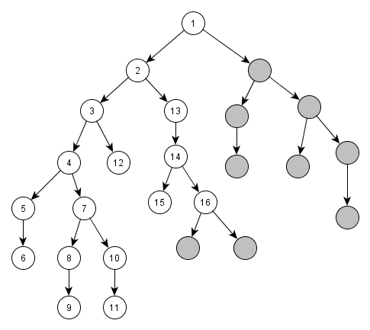


Decision Support Systems
It can be noted that design is inherently a decision-making process, where several decisions have to be taken at different stages in design.
To help the decision-making process, research has been focused towards developing Decision Support Systems (DSS).
Decision-making in system architecting:
1
3
Function | Alternative Designs
1.Deliver Propulsive Power | Piston engine | Electric motor | Fuel Cells
2.Deliver Electrical power | Engine generator | Battery | Engine Generator + Battery
3.Provide stability and control for steady flight | Conventional Tail | V-Tail | H-Tail
4.Provide communication of data | Omni-Dipole, vertically polarization, Gain 2dBi | Omni- circular polarization, Gain 3dBi | Bladed Antenna, Omni -Dipole, vertical polarization, Gain 2dBi
. . . | . . . | . . . | . . .
if(1 == “Piston engine” ) then
{2 != “Battery"}
2
4
The concept selection problem can be represented as a constraint satisfaction problem (CSP).
A variant of recursive depth-first search, known as backtracking search is applied to find feasible system concepts, by removing infeasible system concepts.

Slide 16

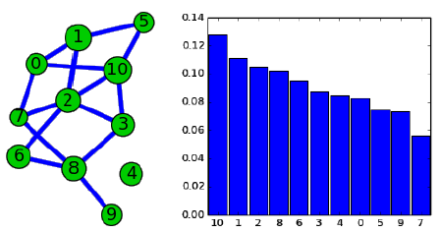

Focused Exploration Strategy
A Focused exploration strategy can be defined by identifying important nodes within the network.
Here important functional nodes are defined as:
Functions that strongly influence system properties such as system value and cost.
Functions that strongly influence the feasibility of other functional nodes i.e. the connectivity of functional nodes.
This is captured by adopting PageRank centrality. This is one of the central algorithms used by Google search to rank websites in their search engine results.
$x_{i}=α\sum_{j}{A_{ij}\frac{x_{j}}{k_{j}^{out}}+β_{i}}$
1. Calculated from network structure
2. Non-network factor – calculated from Multi-Objective Optimisation results.

Slide 17
Questions?

Slide 18
Backup Slides

Slide 19
GA

